Slide 1
Notes:
The repetition part is easily understood by placing some cards edge to edge on a table to represent a layer of strata.

Slide 2
Notes:
Now let’s put a green card on top of each of these to represent a different layer of strata.

Slide 6
Notes:
Now let’s push the two-card packets under the adjacent packet to the right. This results in a pattern…

Slide 7
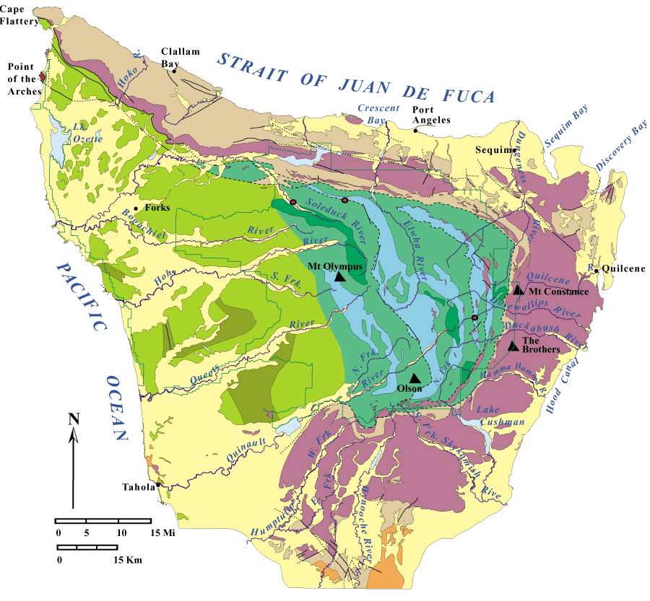
same age
Notes:
… that is not unlike repetition of ages we see in Olympic National Park. This kind of structure is called “thrust duplication” and is fractal in that the pattern is repeated at different scales. In the geologic map we see the largest scale of thrust duplication.

Slide 8
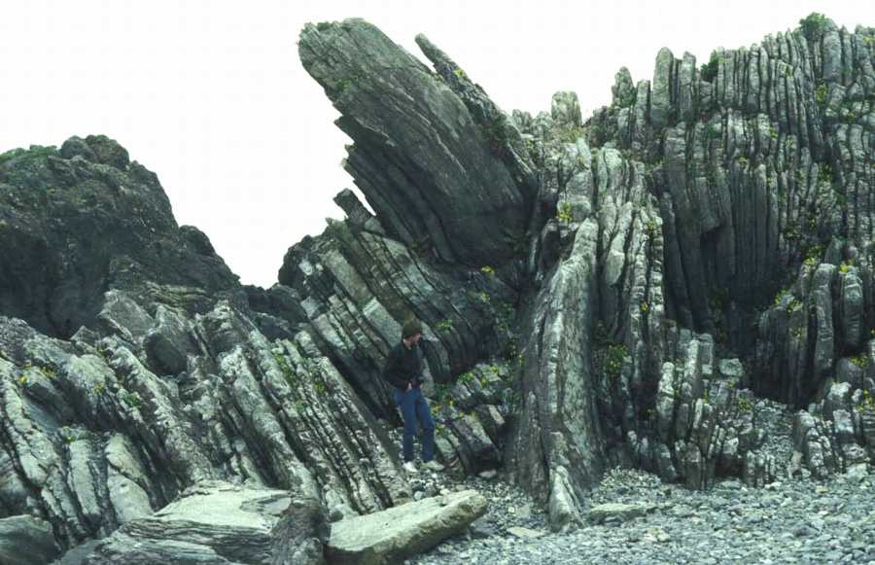
Thrust fault
Same age
Same age
Notes:
But the pattern is seen at smaller …

Slide 9
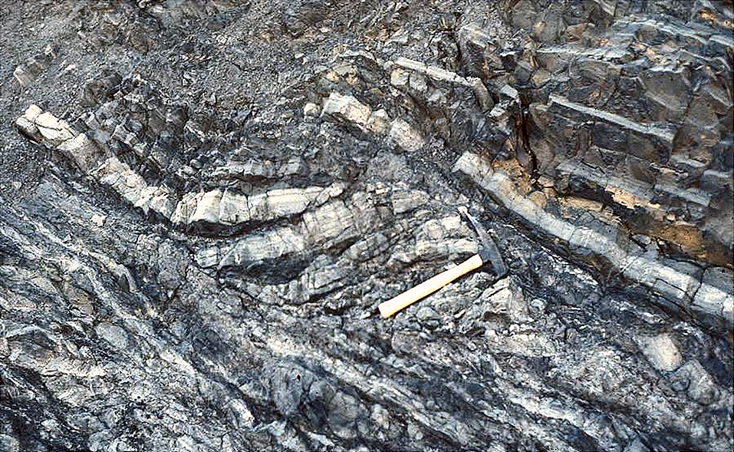
Messy duplexing of sandstone layer
Thrust fault
Same layer
Same layer
Same layer
Same layer
Notes:
.. and smaller..

Slide 10
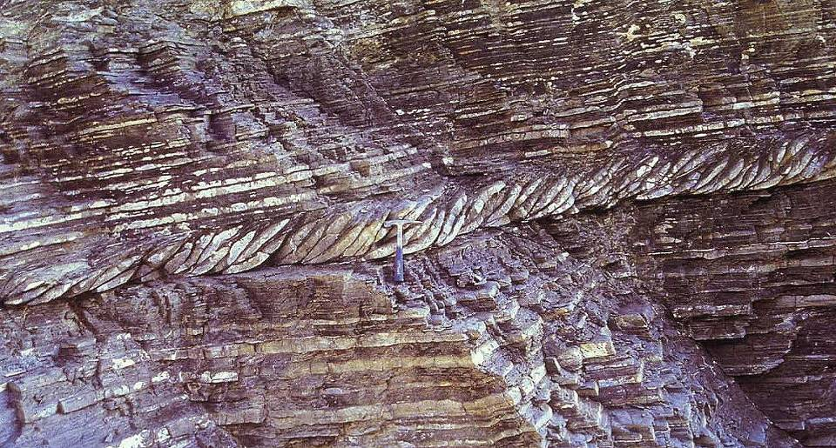
Imbrication or “duplexing” of a single turbidite layer
Notes:
… and smaller scales!

Slide 11
younger
older
Notes:
To explain why younger rocks outcrop to the west, remember that …

Slide 12
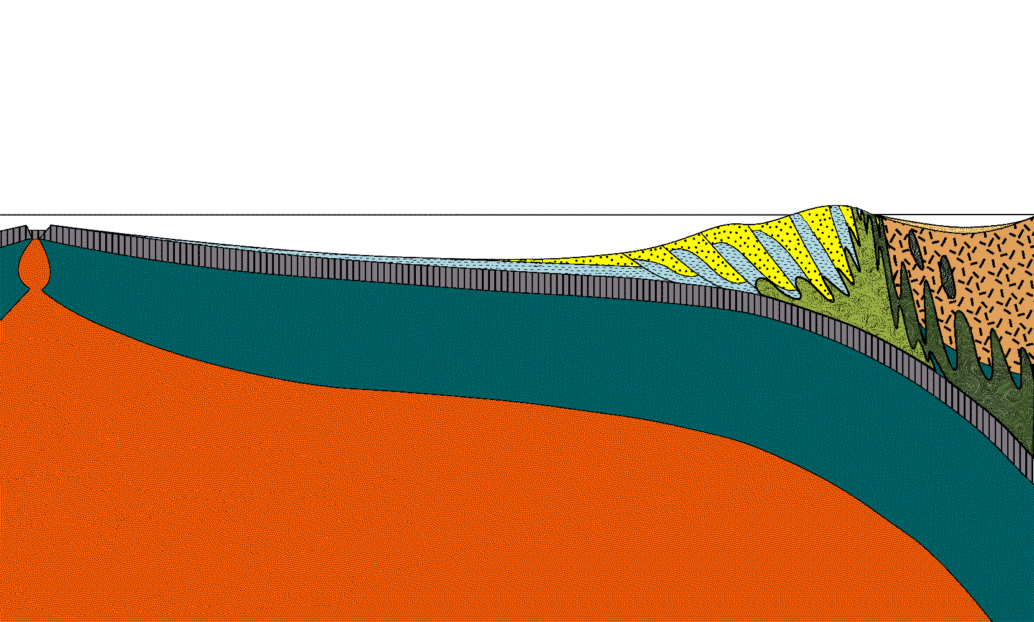
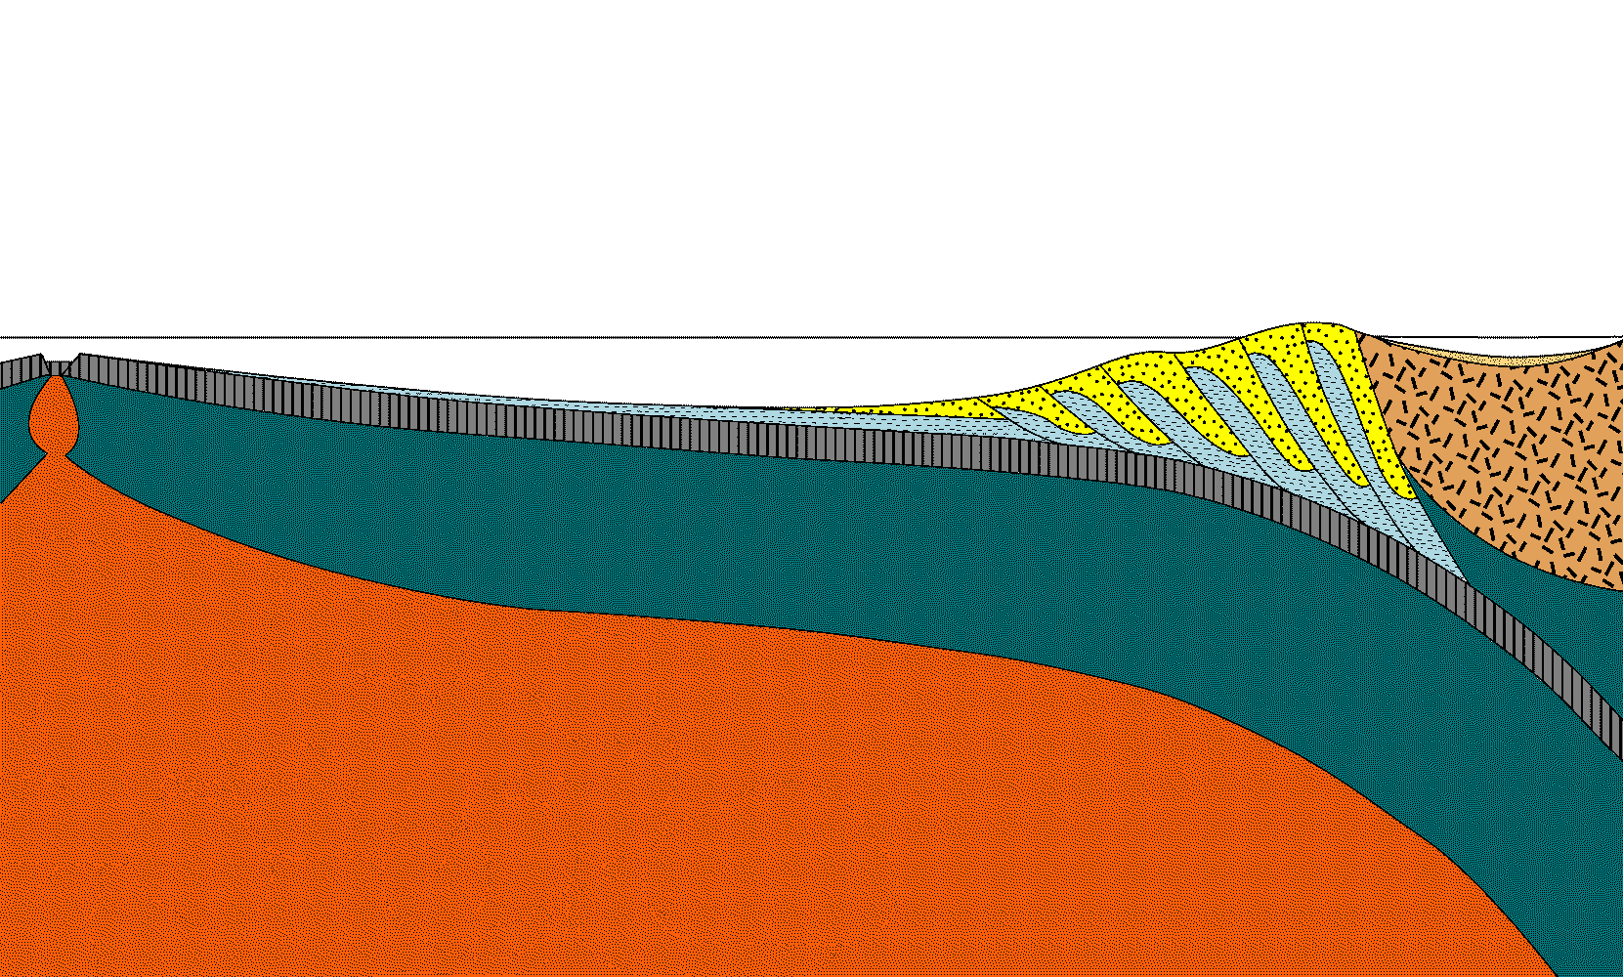
accretionary wedge
younger
older
Notes:
… the accretionary wedge is made from sediments scraped off of the oceanic plate and that the age of that plate gets younger towards the ridge.

Slide 13
younger
older
Notes:
The younger sediments to the west get thrust under the older sediments to east, …

Slide 14
accretionary wedge
younger
older
Notes:
… uplifting and rotating the older rocks to progressively more vertical inclinations.

Slide 15
Notes:
So layers and thrust faults that were initially near-horizontal…

Slide 16
Thrust fault
Same age
Same age
Notes:
… end up near vertical in Olympic National Park. Once exposed at the surface these rocks get weathered, eroded…

Slide 17
Notes:
… washed into the ocean, ...

Slide 18
turbidity current
Notes:
… carried out to sea by turbidity currents ...

Slide 19
Notes:
…where subduction once again works them to the bottom of the accretionary wedge,

Slide 20
Notes:
…only to get uplifted a few million years later and the cycle begins anew.

Slide 21
4-20 million years
Notes:
Depending on how far down the sediments are subducted, the cycle may take as little as 4 million years or as long as 20 million years. Thus in the 20 million years that the wedge has been active, some subducted sediment has made as many five trips around this cycle, while some has not yet reached the surface.

Slide 22
Structural Complexities:
Variation in rock type
Notes:
Superimposed on this general pattern are three structural complexities. First, more than just turbidite and pelagic clay were accreted.

Slide 23
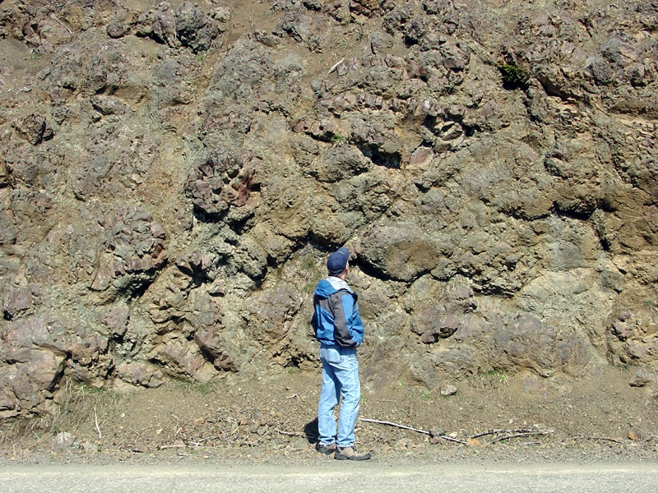
Notes:
Remember all that pillow basalt?

Slide 24
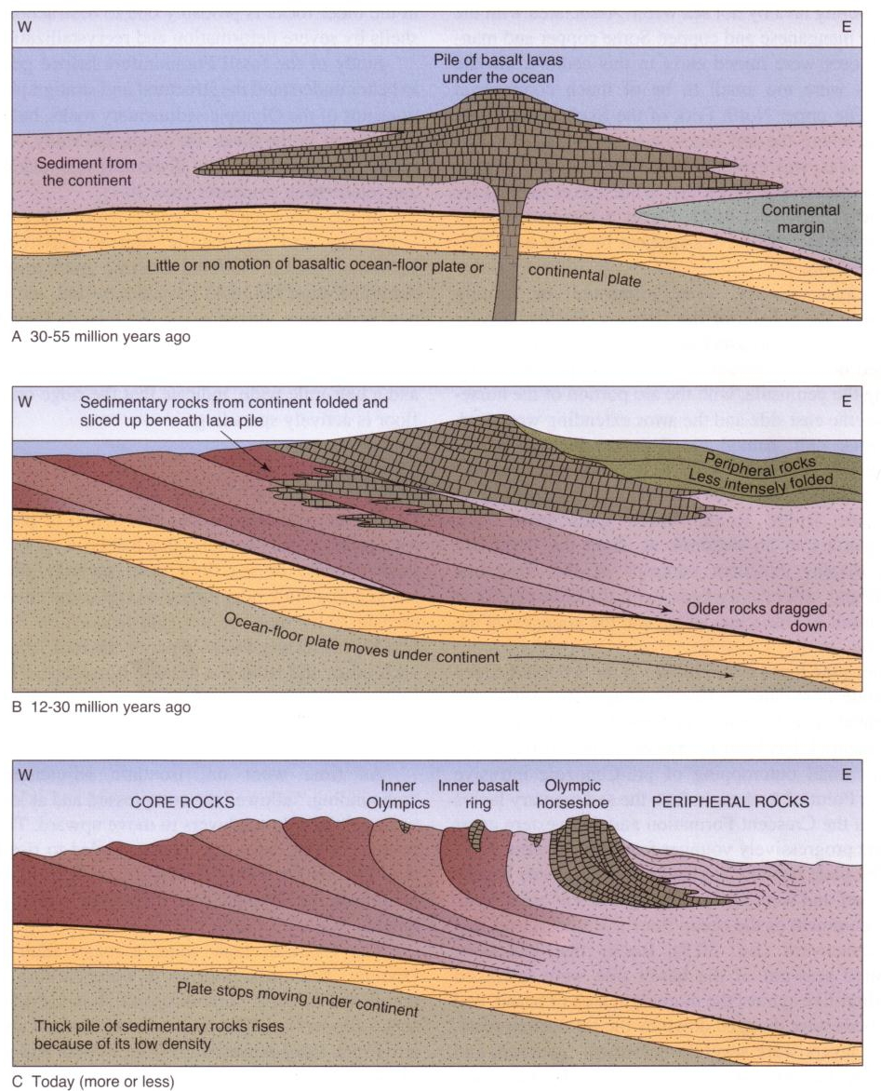
Notes:
Well they erupted from a series of ocean volcanoes much like the Hawaiian Islands, only these volcanoes never reached the surface. When brought to the trench, they were far too large for the subduction zone to “swallow”, and so were scraped off and accreted to the western edge of the North American Plate. Such land masses that did not form in their present location are called exotic terranes.

Slide 25
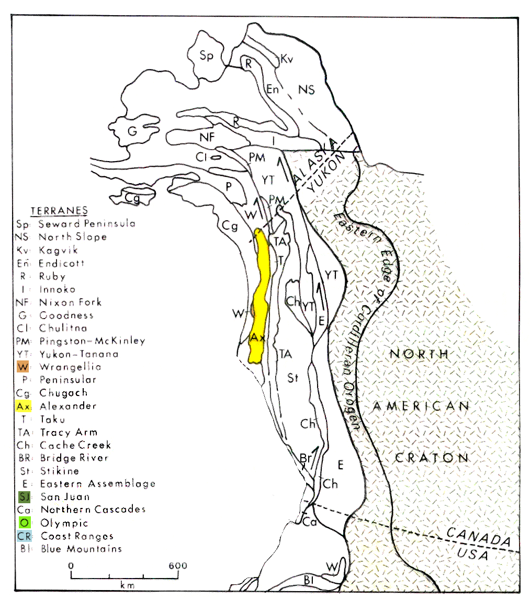
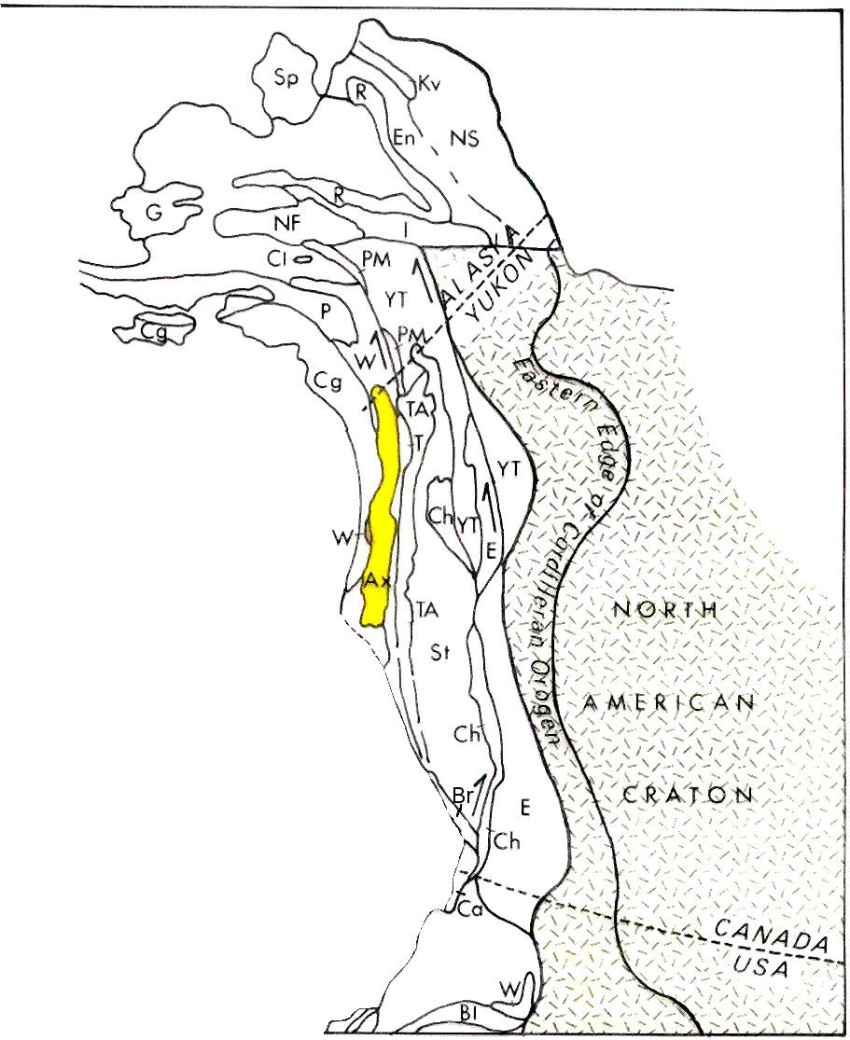
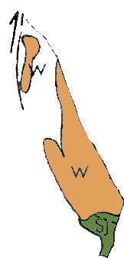
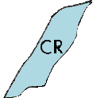
Notes:
Before the Olympic terrane docked, several other terranes had already been accreted, including the Wrangellia, San Juan and Coast Ranges terranes, …

Slide 26
Notes:
… which when accreted left a little nook for the Olympic terrane to squeeze into.

Slide 27
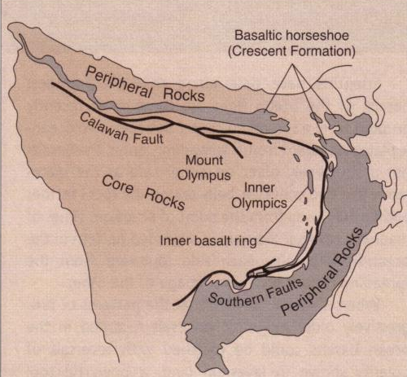
Wrangellia / San Juan
Coast Ranges
Notes:
The basaltic horseshoe formed as the Olympic terrane pressed against the confining Wrangellia, San Juan and Coast Ranges terranes.

Slide 28
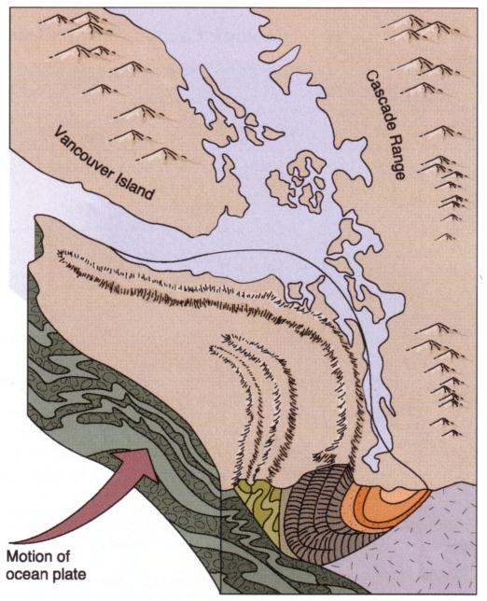
Notes:
Notice that folding also occurs somewhat over and under the basaltic horseshoe as well.

Slide 29
Structural Complexities:
Variation in rock type
Folding in two directions
Notes:
So there is folding in two directions, …

Slide 30
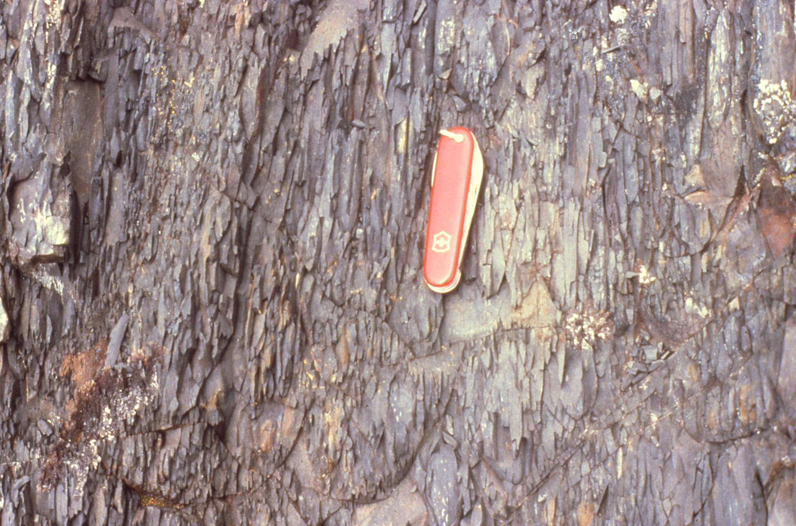
Pencil Slate
Notes:
… which produced an unusual metamorphic rock known as pencil slate.

Slide 31
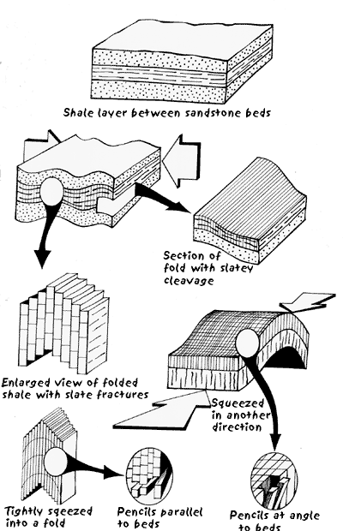
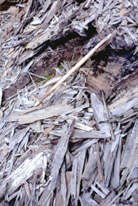
“Pencil” slate
Notes:
Pencil slate forms when there are two directions of folding because folding usually produces slatey cleavage perpendicular to the direction in which the compression was applied. In Olympic National Park a second direction of folding was involved which produced a second direction of slatey cleavage more or less perpendicular to the first.

Slide 32
Structural Complexities:
Variation in rock type
Folding in two directions
Migration of water from subducted plate
Notes:
There is one more important structural complexity we need to explain. That would be the affects of water migrating upwards from the subducted plate.

Slide 33
Hot springs
Wet sediments
Notes:
Water that gets carried down subduction zones comes from two sources. First, water is added to the ocean crust by hot spring systems at the ocean ridge, and second water occurs in the sediments deposited on top of the oceanic crust.

Slide 34
H₂O
H₂O
Notes:
Under higher pressures and temperatures this water is “sweated” out from the subducted crust and sediments into the overlying accretionary wedge and lithospheric mantle.

Slide 35
Mélange
Notes:
When water is added to rocks under high pressures and temperature, it greatly increases ion mobility and metamorphic reaction rates. Combined with the intense shearing that takes place in the deepest parts of the wedge, the enhanced metamorphism due to the addition of water results in a chaotic mixture of rock types, folds and thrust faults named after the French word for mixture – Mélange. Under thrusting of additional sediment eventually works the mélange towards the surface.

Slide 36
Serpentinite
Notes:
When infused with hot, pressurized water, the wedge of lithospheric mantle above the subducted plate is far more unstable than the sediments of the accretionary wedge, so a highly altered rock called serpentinite forms. Serpentinite’s high water content makes it relatively buoyant and plastic, which allows it to rise towards the surface much in the same way salt diapirs do. However, because the Olympic accretionary wedge is fairly young, relatively little serpentinite or mélange have formed and too little erosion has occurred to expose much of these rock types in the Park. Mélange and serpentinite are far more common in older accretionary wedges like in Redwood National Park.

Slide 37
H₂O
H₂O
Notes:
Nonetheless there are two surface expressions of the large amount of hot, pressurized water rising from the subducted plate.

Slide 38
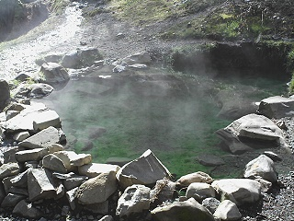
Hot Springs
Notes:
The most obvious would seem to be the numerous hot springs in the park, but most of the water here is surface water that has circulated to great depth along fault zones and resurfaced.

Slide 39
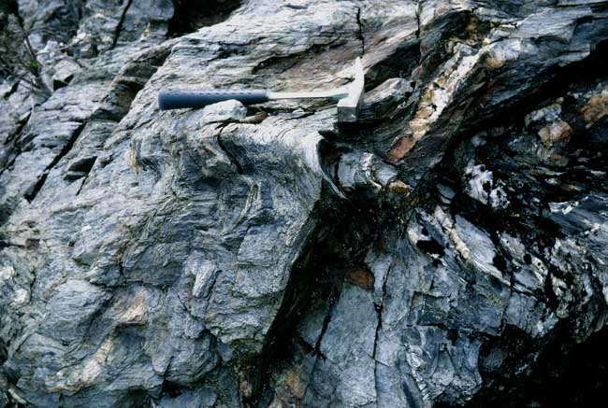
Quartz veins
Notes:
Quartz veins are less ambiguously related to the action of water emanating from the subducted plate. They form as silica is reprecipitated near the surface after being dissolved from siliceous ooze and reworked turbidites by the hot, pressurized water at depth.

Slide 40
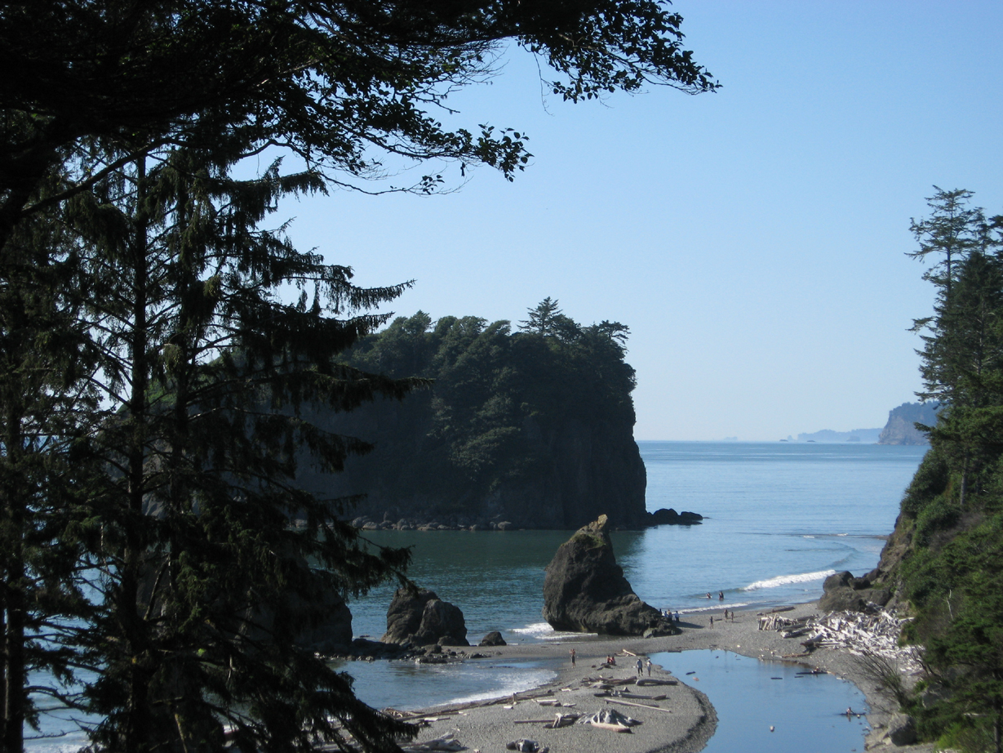
Coastal Processes
Notes:
The dynamic interaction created by uplift of the accretionary wedge combined with wave erosion and deposition by rivers and glaciers created some noteworthy coastal landforms.

Slide 41
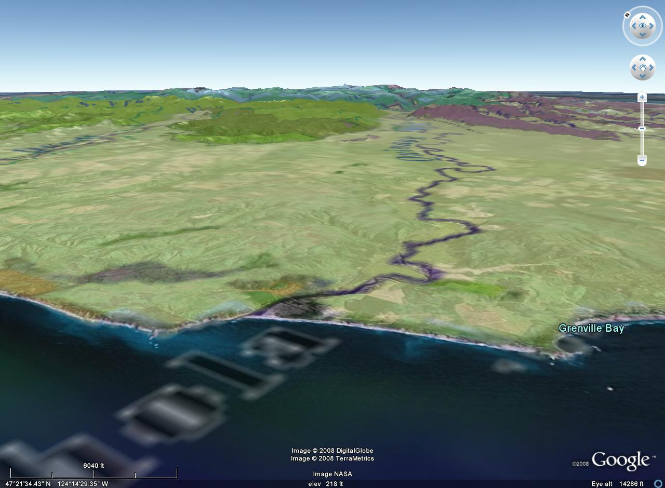
MARINE TERRACE
Notes:
First up notice that the foothills of the Olympic Mountains all reach about the same maximum elevation such that the coastal area is essentially a vast, partially eroded plain. This surface, now called a marine terrace, is underlain by a thick layer of glacial and fluvial (river) sediments deposited at or near sea level during a time when the land was lower and the sea was higher. The layer extended much further beyond the present shoreline, but following the uplift of the land and lowering of sea level, waves and rivers have eroded much of the terrace …

Slide 42
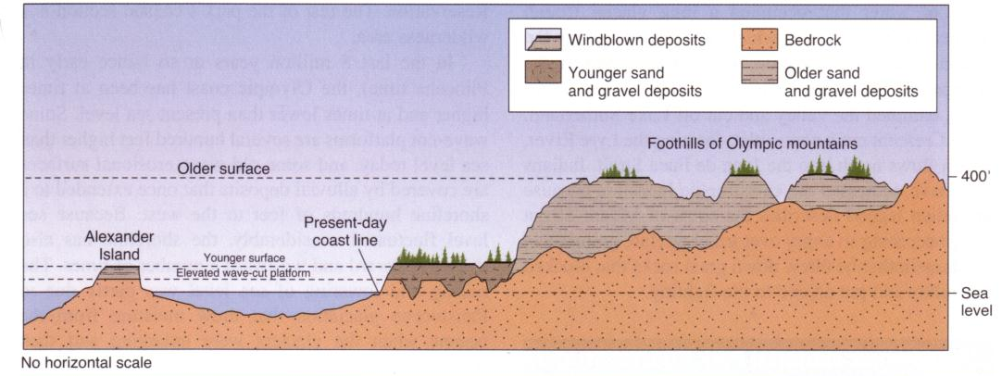
Remnants of older, near sea level surface
Notes:
… leaving remnants of the former surface and …

Slide 43
Sediments deposited on wave cut platform
Notes:
… while forming a wave-cut platform near sea-level, on top of which a thinner sequence of sediments deposited. As was the case for the older sediments, uplift of the land and lowering of sea level exposed these sediments above sea level where they were eroded by wave action and to a lesser degree runoff. More erosion-resistant areas like Alexander Island …

Slide 44
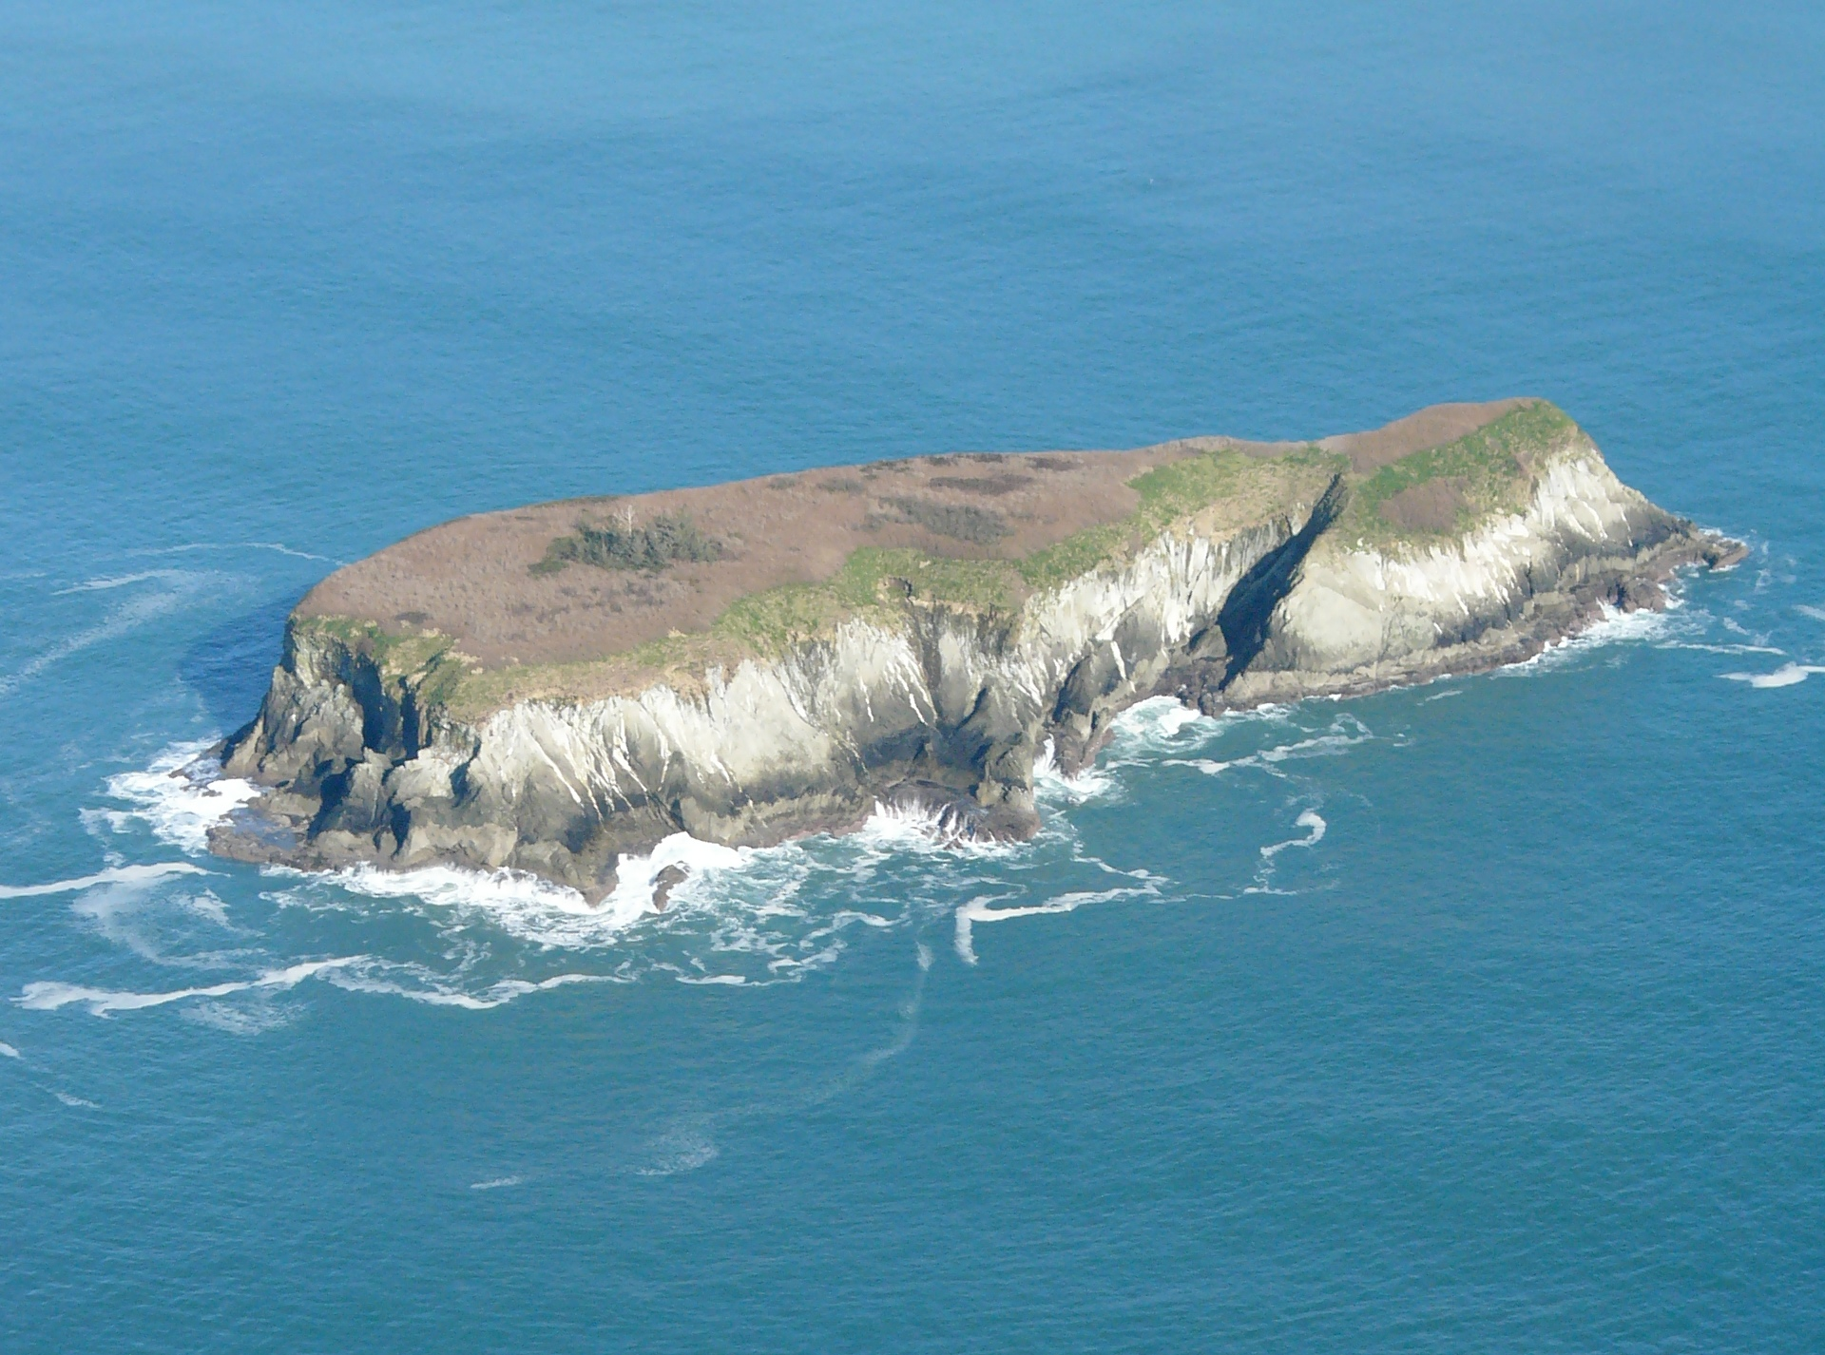
Alexander Island
MARINE TERRACE
Layer of sediment deposited on wave cut platform
Notes:
… preserve isolated remnants of the former sediment layer and are capped by a relatively young marine terrace.

Slide 45
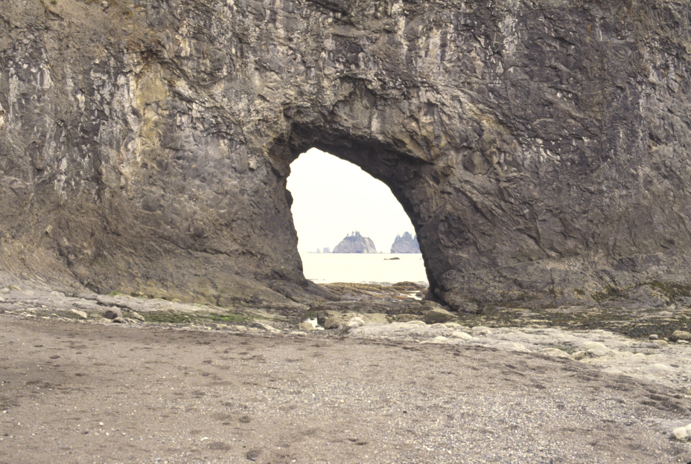
Future Sea Stack
Sea Arch
Notes:
The highly variable rock types of accretionary wedges also led to variations in wave erosion rates. Sea arches form along headlands (points) where especially erodible rocks occur. If the arch enlarges and eventually collapses, a remnant of the former headland remains …

Slide 46
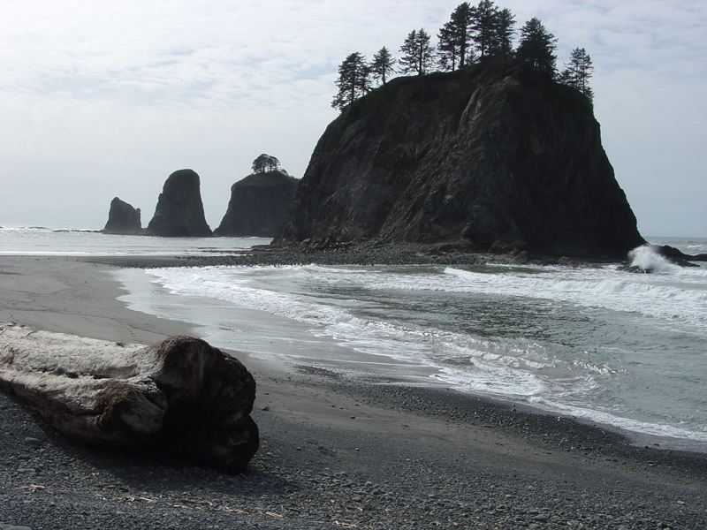
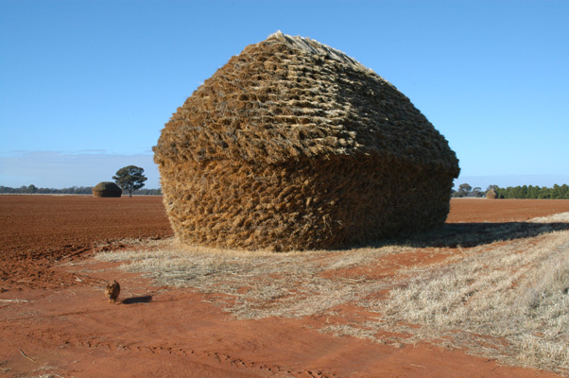
Sea Stack
Hay stack
Notes:
… called a sea stack, so named after their resemblance to hay stacks.

Slide 47
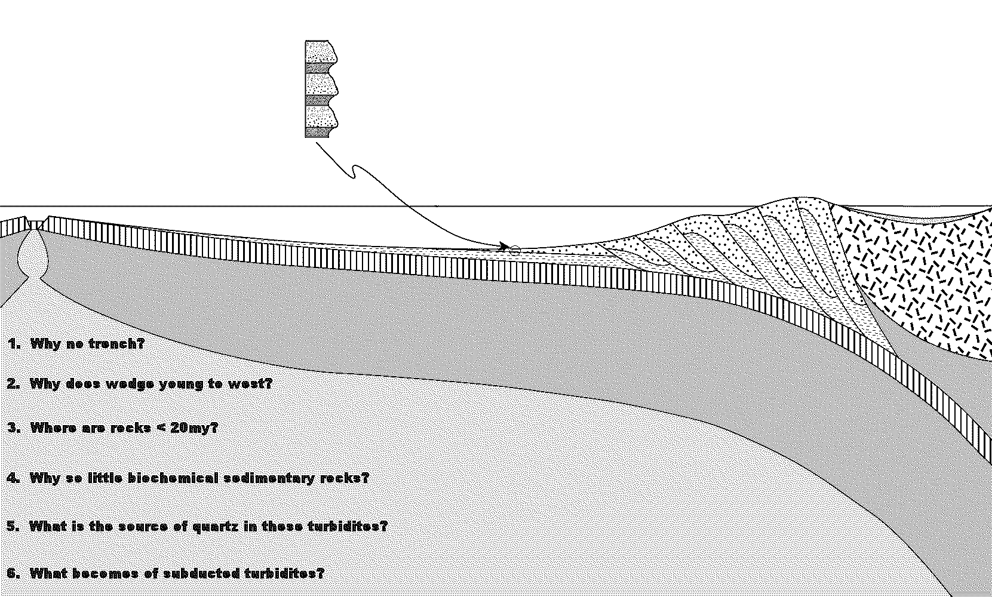
Notes:
I have put together a model of the accretionary wedge in Olympic National Park for you

Slide 48
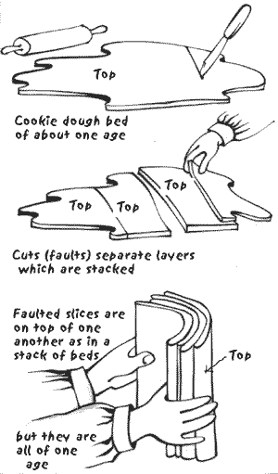

Slide 49
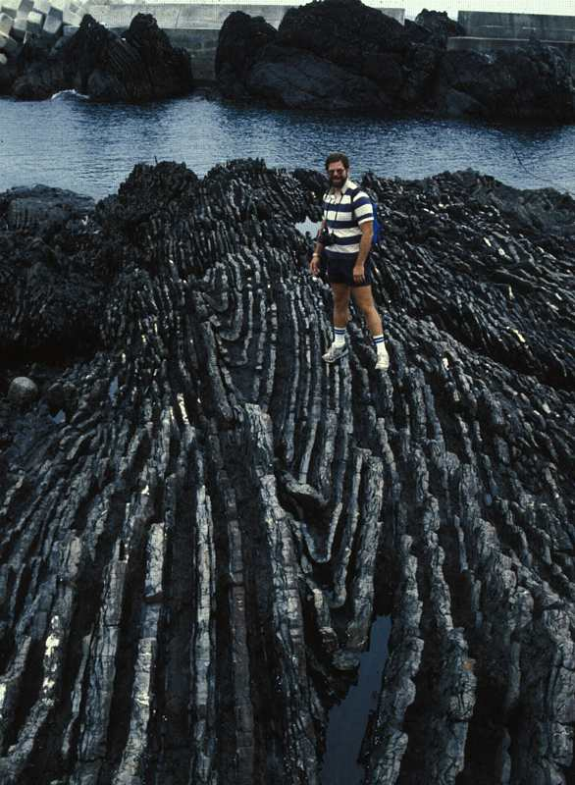
Drag fold in turbidite formed by shearing
Notes:
Footwall cutoff with development of a small drag fold, Tertiary turbidite sequence of accretionary prism of SW Japan

Slide 50
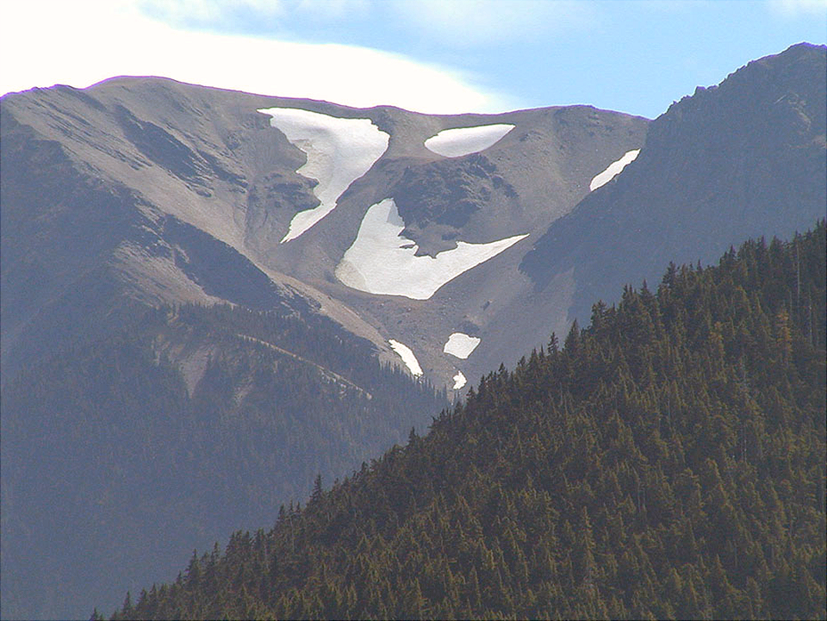
Notes:
Here there are vast exposures of beautifully bare rock!

Slide 52
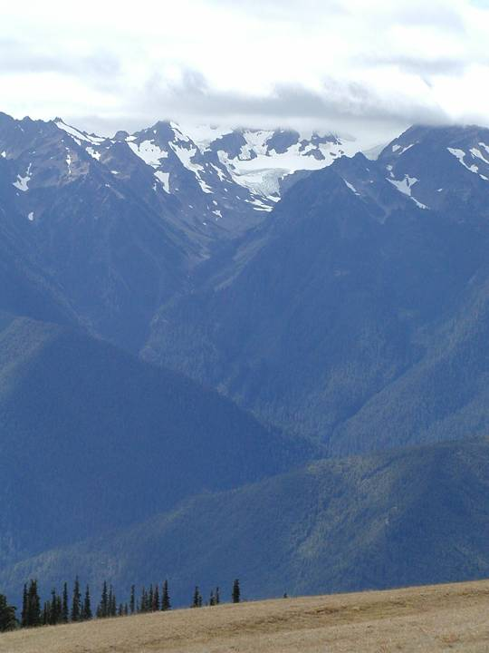

Slide 53
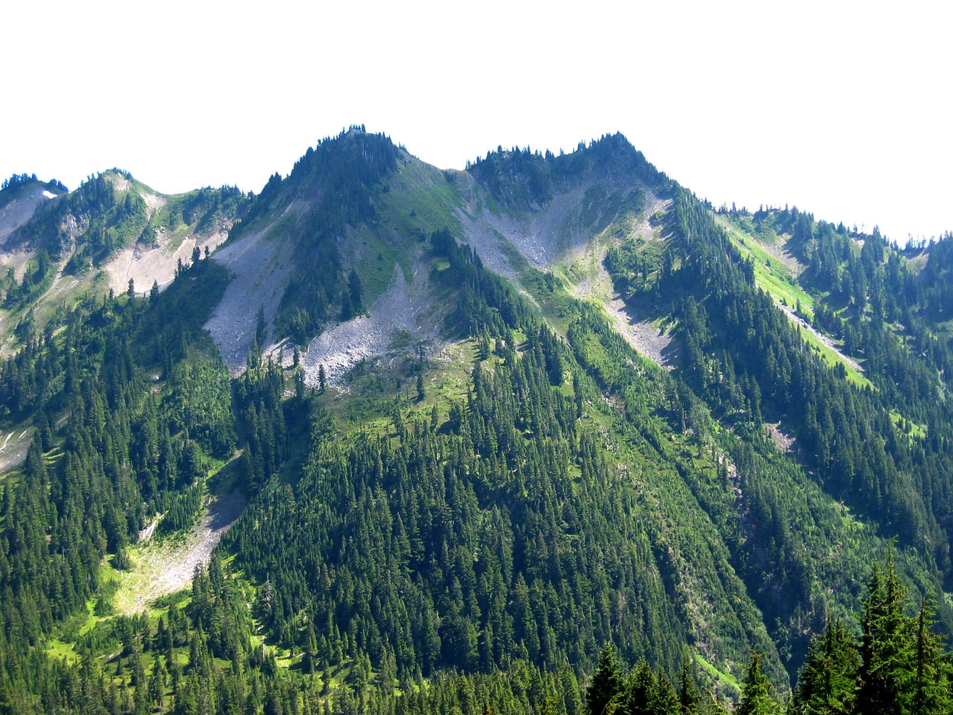

Slide 54
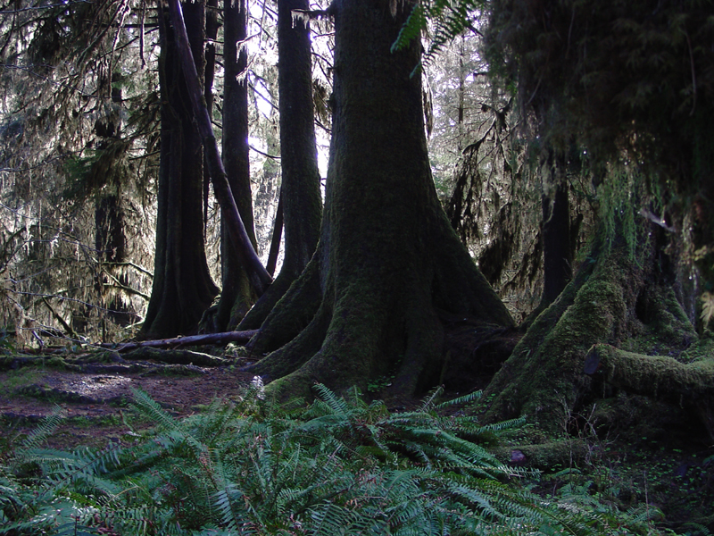

Slide 55
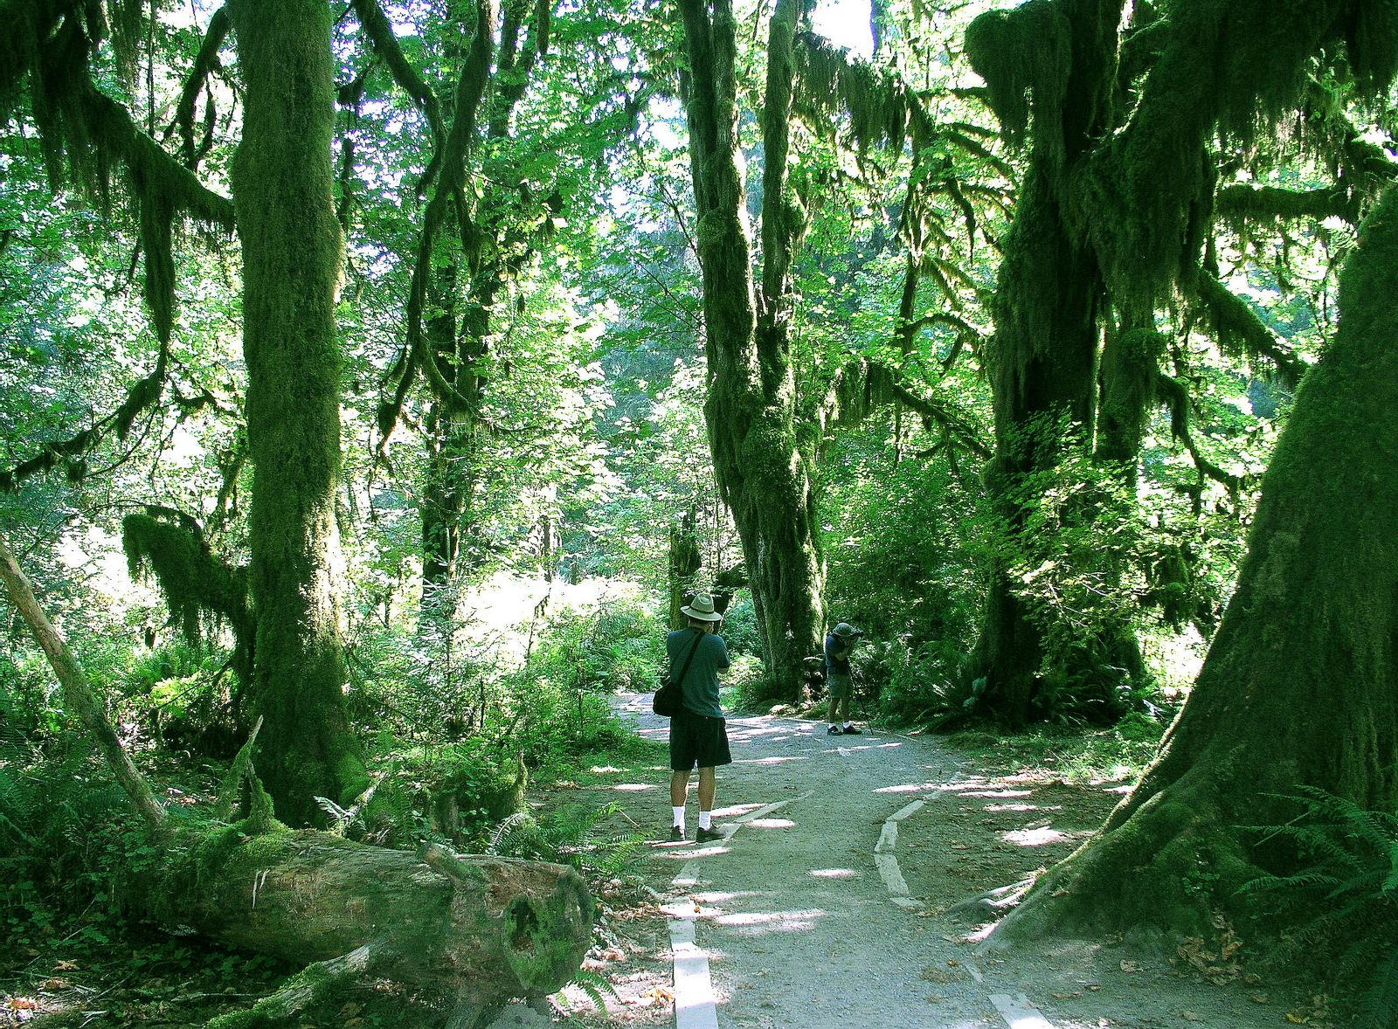

Slide 56
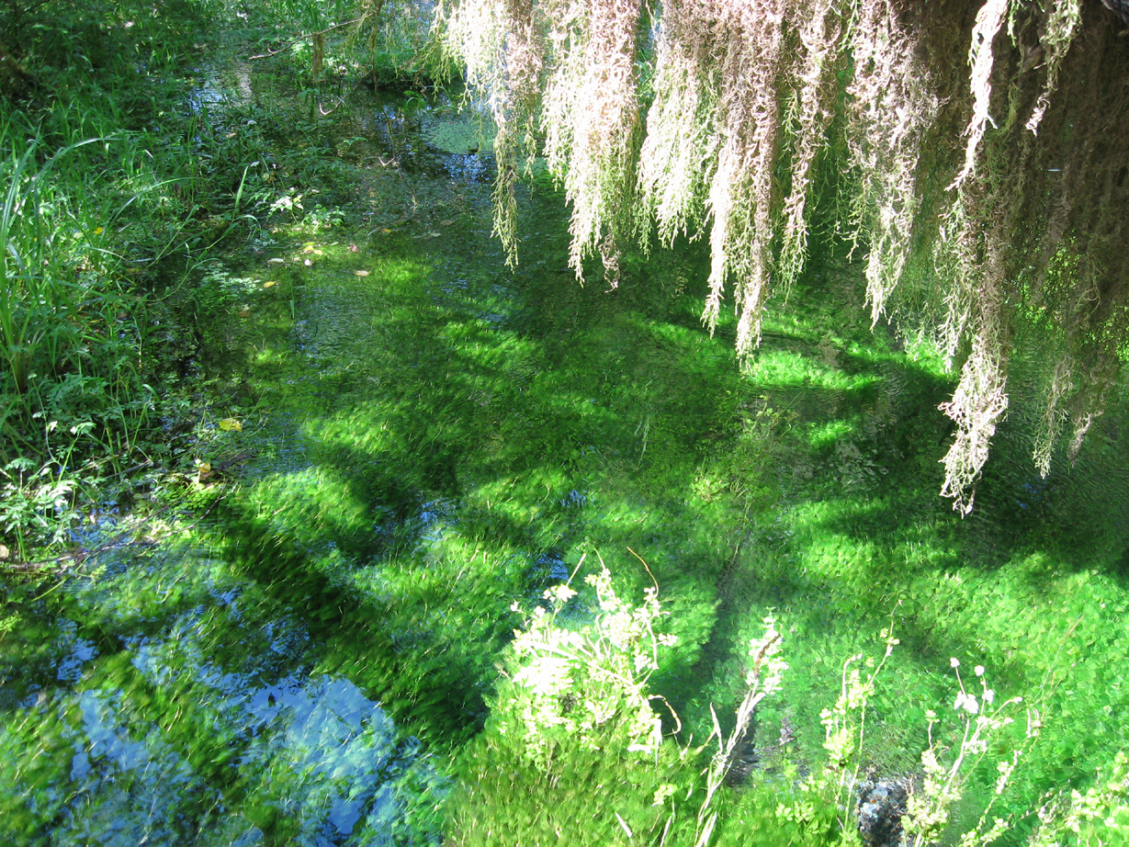

Slide 57
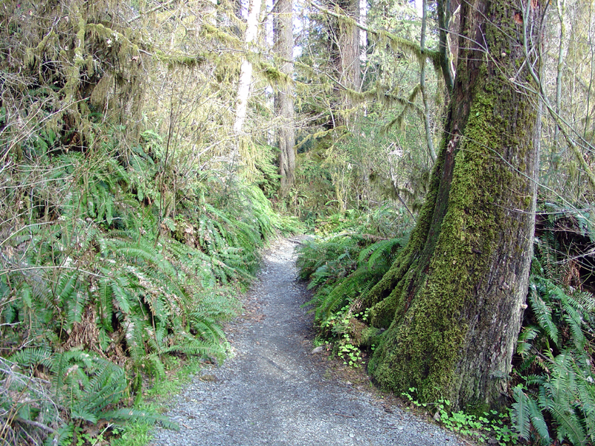
Notes:
… so a hike through the park yields little to interest the die hard geologist.

Slide 58
